Slide 1
Design, Develop, Implement, Test & Document Used Car Sales Portal Website
Module Project
Module: Application Development & Process
Start Date : 04 April 2023
End Date : 06 Mei 2023
Submission Date : 10/05/2023
Learner Name : Muhamad kemal
Enrollment ID : bdse-0922-084
Presentation Date :

Slide 2
Contents
Document History
Version Number | Effective Date of release | Summary of Included Changes | Author

Slide 3
Contents
Contents
S. No. | Description
01 | List of software used
02 | Business Process
03 | Project Plan
04 | Stages of Risk Based Testing models
05 | Types of risks
06 | Risk Based Testing Strategies
07 | Qualitative and Quantitative Risk Analysis
08 | Security Testing
09 | Test plans and Test cases
10 | Logs of Test Results
11 | Modifications of fail Test Cases
12 | Effectiveness of RBT strategy
13 | Project Results

Slide 4





1. List of software used
STS IDE <screen capture>
Software | Purpose
Spring Tool Suite 3 | Java IDE used to develop web application based used car sales website
MySQL Workbench | Visual database design tool that allows to create, manage, and administer MySQL databases.
Lambdatest.com | Used to conduct cross-browser testing
Ngrok | Used to generate a forwarding URL for cross-browser testing
Microsoft Word | Used to write Application Development & Make report or doccumentation

Slide 5
2. Business Process
Post car
<algorithm/flow of the business process>
Document 2 Business Process
Scenario 1 – Register User
1. Enter the URL http://localhost:9090 to access the used car sales portal
2. click Register in navbar
3. the user must fill in data such as Name, Username, Email, Password. then click submit
4. User will see a register success message
Scenario 2- Post Car
Enter the URL http://localhost:9090 to access the used car sales portal
2. Click ‘Register’ and enter name, username, email and password to register as new user
3. The message "Register Success" will include a link to the login page for users.
4. On the login page, enter your registered username and password.
5. User can search for car by navigating to the search bar on the header and click it
6. User can search for car by make, model, registration and price
7. Search for model “toyota” and click ‘search’
8. User will see a search result page containing all list of cars matching the search keyword

Slide 6
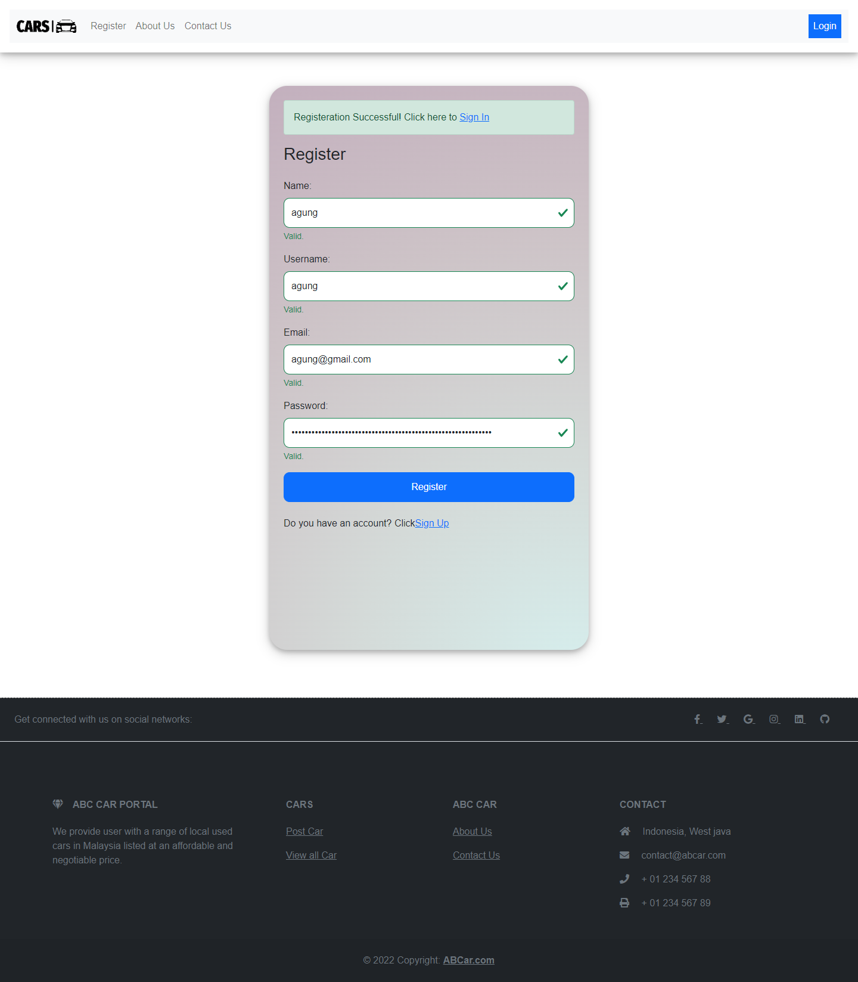
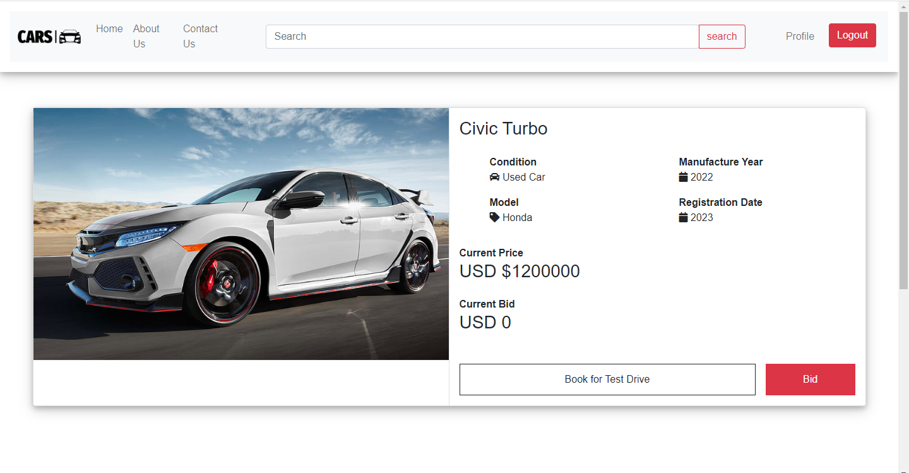
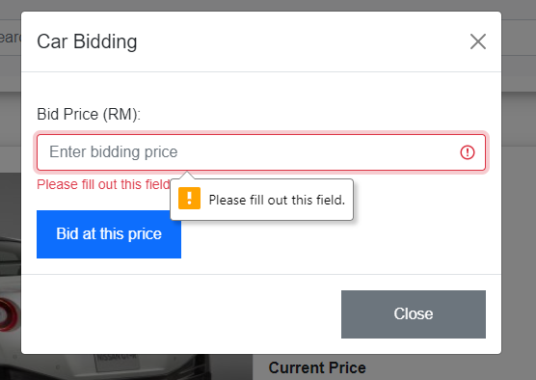
2. Business Process
UI screenshot
i. Scenario – registration

Slide 7
3. Project Plan
<Add the project plan table>
Pages | Functionality
Register | To register new user for the abc car portal by storing user’s information such as user’s name, username, email and password
Login | To validate user registered credentials, username and password before user can actually access the portal
Home | The first page seen by user after successful login which contains list of all car posted and post a car sale form
Car Detail | Allows user to see the car details after they are posting a new car for sale or selecting the listing car detail button from selected list of all car in home page or search results
Search Result | The result page after user search for car according to the details of the car such as make, model, registration or price in the search bar located on the header and showing the list of car matching to the search keyword
Profile | In this page user is allowed to update profile their detail information such as mobile, address, avatar. Also user can track posted car sale and booking status or removing the posted car for sale
User Management | To allow administrator to view and manage list of registered users, this page can only access by administrator, administrator can do various functionality such as mark a user as administrator or update their profile or delete the user
Car Management | Same as user management page, in this page Administrator can perform varios functinality to manage all the posted car in the portal such as delete car post, update status for user booking based on bidding or updating status for car sale
About Us | Page seen by user which contains description about the abc used car sales portal
Contact Us | Page seen by user which contains contact information to reach abc used car sales

Slide 8
4. Stages of Risk Based Testing model
Risk identifying | Risk Impact Analysis | Risk Mitigating | Risk Monitoring
Various ways to identify risk includes: -Brainstorming Interviewing The risk can alternatively be divided into three groups, including: • Known risk - Functional risk - Non-functional risk - Technical risk • Unknown risk: appear during testing: - Not enough resources - Delayed testing due to sudden defect appearing • Unknowable risk: not anticipated and having critical impact: - System down for more than 1 day - Natural calamities | Project managers can use the risk matrix to evaluate how likely a risk is to materialize and how much it would impact the project. Project managers can prioritize which hazards require the greatest attention by giving them a value on a scale. It's a strategy to guarantee that hazards are recognized and handled in a methodical and efficient manner. | Developing a response strategy to manage risks comes next once risks have been identified and evaluated. The response plan can comprise either getting rid of the danger or lessening its effects to a manageable level. This is known as risk minimization, and it is an important aspect of risk management in software development. | Monitoring and controlling risks entails keeping an eye out for those that may still exist and recognizing any new ones that may appear as the project progresses. The team can employ techniques including risk reassessment, auditing, trend analysis, and project status updates in meetings to monitor and control risk.

Slide 9
5. Types of risks
Type of risk | Risk identification | Risk description | Impact
Functional | Login risk | User is not able to login | Users won't be able to enjoy all of the functions offered by the website if they are unable to log in.
 | Searching risk | User is not able to seach a car | The user must search manually to find a specific car because it is difficult to do so through the portal.
 | Posting a car risk | User is not able to post his car | The user cannot use the site to post a car for sale.
 | Viewing car detail risk | User is not able to view selected car details | User cannot place a bid, make a reservation, or view the details for a certain automobile.
 | Data is not saved, deleted, or updated in the database | No rows affected during the operation | The application won't function properly in its entirety or with some features.
Non-Functional Risk | Performance | Home page is not loading in expected time | The user would eventually choose another website that better suits their demands after losing interest and patience in the first one.
 | Compatibility | Home page has different look and feel into different browsers | User will lose interest due to the difference of user interface
 | Maintainability | Used car portal cannot be modified or make changes | User will judge the portal as not up to date
 | Usability | The portal is not easy to navigate and does not have clear label or instructions to use | users may find it difficult to learn and use the software, leading to frustration and potential abandonment of the product.
Technical Risk | Security | The user is not authenticated correctly after logging in | User will not be able to log in to the portal and reach the home page
 |  | Navigation is not properly authorized based on the user's login role assigned | The user will have unauthorized access to sensitive information or functionality

Slide 10
5. Types of risks
 |  | SQL injection | it can lead to data breaches, loss of sensitive information, and compromise of system integrity
 | Portability | Used car sale portal look and feel is different in phone/mobile devices | Users who are accustomed to utilizing a particular gadget will stop using the website.

Slide 11
6. Risk Based Testing Strategies
Risk Id | Test Scenario ID | Test Scenario | Test Objective | Test Priority | Risk | Technique | Expected Results
1 | UA001 | Ensure user can register in the portal | To allow user to register with their credentials (name, username, email, password) successfully | High | User is not able to register with their credentials | UAT Testing | After registering user will see the succes message and their credentials saved in the database
2 | UA002 | Ensure user can login in the portal | To allow user to login with registered credentials | High | User is not able to log in with registered credentials | UAT Testing | After login, user will reach to the home page
3 | UA003 | Ensure user car post a car in the portal | To allow user to post a car in the portal | High | User is not able to post a car in the portal | UAT Testing | Users can post their car in the portal
4 | UA004 | Ensure user can search and view car detail | To allow user to search a particular car in the portal | High | User is not able to find the expected car | UAT Testing | After giving the keyword user will see matched search result
5 | UA005 | Ensure user can update his profile | To allow user to update their profile | High | Users is not able to update their profile | UAT Testing | Users can see updated details in their profile

Slide 12
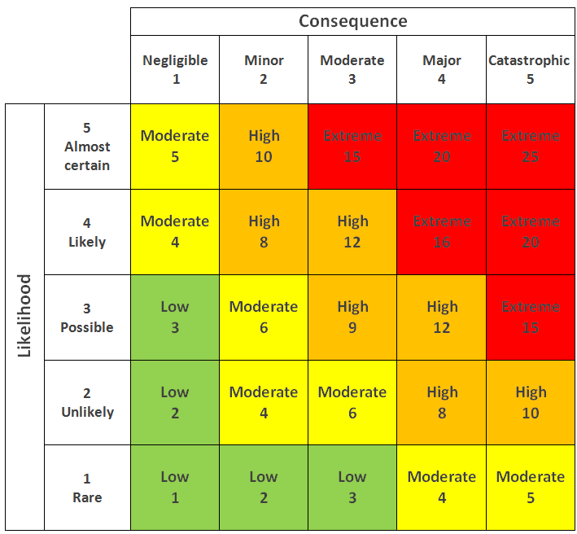
6. Risk Based Testing Strategies
Risk ID | Risk | Likelihood (1-5) | Impact (1 – 5) | Type of Testing | Risk Rating | Risk Level
1 | User is not be able register in the system | 3 | 4 | UAT Testing | 12 | High
2 | User will not be able to reach the portal home page to post or view cars | 3 | 4 | UAT Testing | 12 | High
3 | User will not be able to sell their car | 3 | 4 | UAT Testing | 12 | High
4 | User will not be able to find the car expected | 3 | 3 | UAT Testing | 9 | High
5 | User will not be able to complete their profile information | 3 | 3 | UAT Testing | 9 | High
Insert the 5x5 matrix that’s used in the risk assessment

Slide 13
6. Risk Based Testing Strategies
Risk Analysis
Identify all possible risk -Categorize the risk into functional , technical and , non functional risk. Assess the risk level using the risk matrix Prioritize the extreme high risk
Test planning
SDLC Model, spiral model is selected Test plan and schedule are prepared tn the basis of risk assessment
Test Execution
Test execution is …… UAT Unit Performance Compability Portability Usability security

Slide 14
7.Qualitative and Quantitative Risk Analysis
Qualitative Risk Analysis | Quantitative Risk Analysis
Qualitative risk analysis is subjective Predict risk severity by likelihood and impact using a risk assessment matrix Lacking numeral estimate for fund or budget | Quantitative risk analysis is objective Include prioritized list of risk done using a risk matrix Includes reliable data such as completion Time ,schedule, budget resources and so on

Slide 15
8. Security Testing
Security Testing is a form of software testing
- What is security testing ?
Software testing that focuses on finding holes and flaws in a system's or application's security defenses is known as security testing. To make sure that the system or application is safe from potential risks like hacking, unauthorized access, data breaches, and other cyber-attacks, security testing is conducted.
-Types of security testing
- How it is conducted- Authentication, Authorization, SQL injection.
To make sure that the system only permits authorized users to access it, authentication testing is done by attempting to get into the system using multiple sorts of credentials, such as legitimate and illegitimate usernames and passwords.
To make sure that the system only permits authorized users to access certain resources or take certain actions, authorization testing is carried out by making an effort to access those resources or do those actions.
To test whether the system can recognize and thwart these kinds of attacks, malicious SQL code is intentionally injected into the system.

Slide 16
9. Test plans and Test cases
Test plan : A Test Plan is a concept and deliverable that defines the strategy that will be used to verifiy that the product or system is develoved according to its specification and requirement.
Test case : Test case consist of test case name , precondition , steps / input condition , excepted result .
Functional testing
UAT-
2. Unit testing
2. Performance testing
Requiment | Test Scenario ID | Test Scenario | Number of test test Cases
Functional Testing | UA001 – UAT Testing | Ensure user can register in the portal | 1
Requiment | Test Scenario ID | Test Scenario | Number of test test Cases
Functional Testing | TS001 – Unit Testing | Validating registration functionality | 1
Requiment | Test Scenario ID | Test Scenario | Number of test test Cases
Functional Testing | PM001 – Performance testing | Testing performance of registration | 1

Slide 17
Test log is typically a study object which is reviewed over the process of the preparation……
Test Scenario ID | Test Case ID | Test Case | Pre-condition | Expected Result | Actual Result | Pass/ Fail
UA001 | UATC001 | Check all the mandatory fields are entered | ABC Cars Portal website has completed and uploaded on server | After registering, user will see a successful registration message and a login link. | Result is come out as expected | Pass
Test data and steps | Name= kemal Username = kemal Email= kemal@gmail.com Password= kemal 1. Enter URL localhost:8080 2. Click “Register” on website navigation bar 3. Enter all the fields. 4. Click Register.

Slide 18
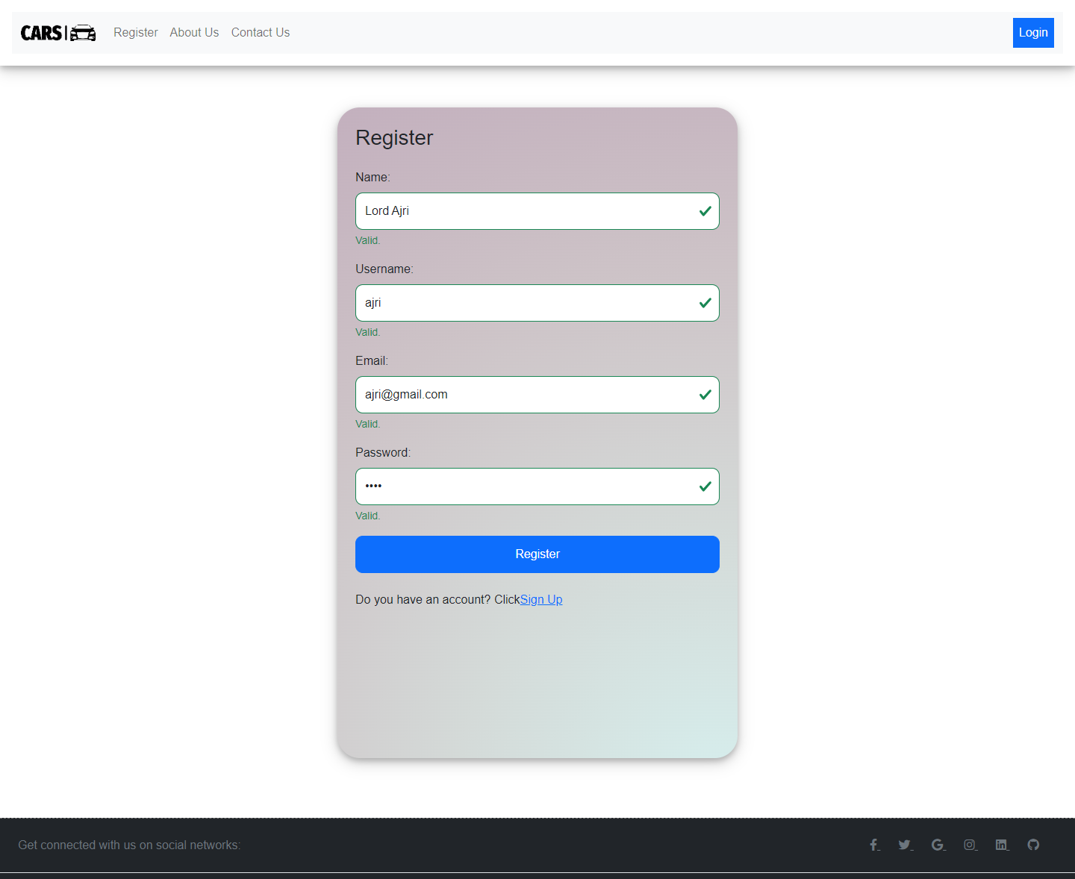

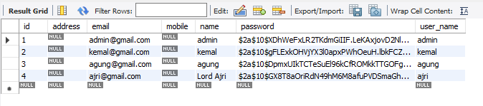

Slide 19
Scenario ID | Test Case ID | Test Case | Preconditions | Steps | Test Data | Expected Result | Actual Result | Pass/ Fail
TS002 | TC001 | Check if user credential is existing in the system | Implementation of ABC Car Portal is complete with all webpages and navigation links and uploaded on localhost server | Run Test script shown in screenshot below | Username = rahman | After checking, junit should return a passing result as user data exist/present in the system | Not As expected, | Fail

Slide 20
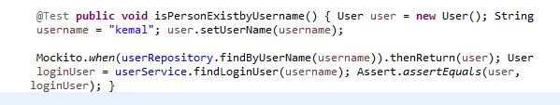
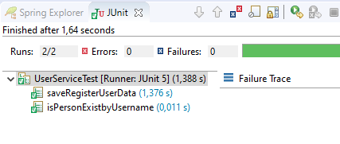

Slide 21
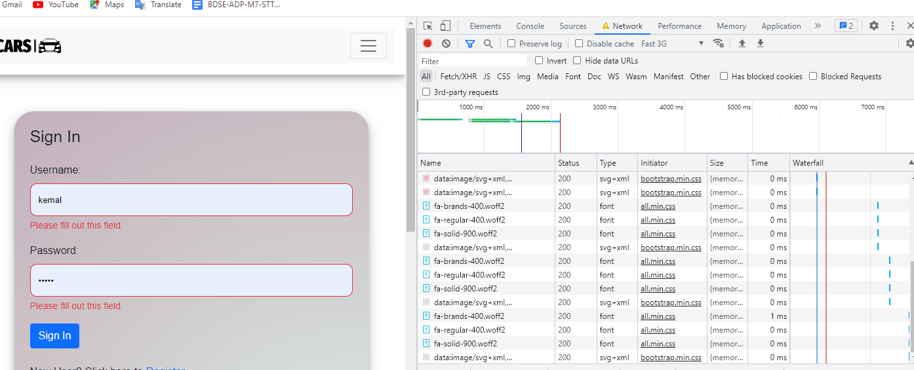

Slide 22
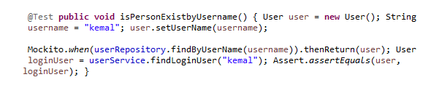
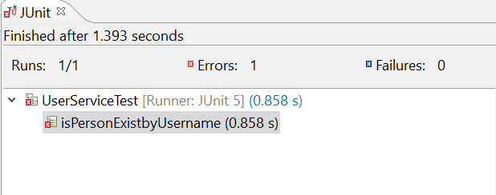
Before modification
After Modification, JUnit shows a passing result

Slide 23
10. Modifaciton of fail test cases
 | Used Car Sale Portal Project
Reported By: | Muhammad kemal
Report Date: | 06/05/2023
Tested By: | Muhammad Kemal
Tested Date: | 06/05/2023
Testing Name/ Test Scenario ID | Functional testing:- Unit Testing/ TS001 / TS002 / TS003 / TS004 /TS005
Total Number of Test Cases | 5
No. of Pass: | 4
No. of Failures: | 1
Elapsed Time: | 00:45:00
Tested By: | Muhammad kemal
Tested Date: | 06/05/2023
Testing Name/ Test Scenario ID | Functional testing: -UAT Testing/ UA001 / UA002 / UA003 / UA004 /UA005
Total Number of Test Cases | 10
No. of Pass: | 9
No. of Failures: | 1
Elapsed Time: | 00:35:00
Tested By: | Muhammad kemal
Tested Date: | 06/05/2023
Testing Name/ Test Scenario ID | Performance Testing/ PM001
Total Number of Test Cases | 2
No. of Pass: | 2
No. of Failures: | 0
Elapsed Time: | 00:15:00
Tested By: | Muhammad kemal
Tested Date: | 06/05/2023
Testing Name/ Test Scenario ID | Compatibility Testing/ CB001 / CB002 / CB003 / CB004 / CB005
Total Number of Test Cases | 15
No. of Pass: | 15
No. of Failures: | 0
Elapsed Time: | 00:45:00
Tested By: | Muhammad kemal
Tested Date: | 06/05/2023
Testing Name/ Test Scenario ID | Usability Testing/ UB001/ UB002/UB003/UB004/UB005
Total Number of Test Cases | 5
No. of Pass: | 4
No. of Failures: | 1
Elapsed Time: | 00:25:00

Slide 24
11.Modification of fail test cases
Test Scenario ID | Test Case ID | Test Case | Pre-condition | Expected Result | Actual Result | Pass/ Fail
TS001 | TC001 | Check if user credential is existing in the system | Implementation of ABC Car Portal is complete with all webpages and navigation links and uploaded on localhost server | After checking, junit should return a passing result as user data exist/present in the system | Not As expected | pass
Test Step & Test data | Name= kemal Username = kemal Email= kemal@gmail.com Password= kemal
Log Result after modification

Slide 25
11.Modification of fail test cases
Project ID/ Project Name: | Used Car Sale Portal Project
Reported By: | Muhammad kemal
Report Date: | 06/05/2023
Tested By: | Muhammad kemal
Tested Date: | 06/05/2023
Testing Name/ Test Scenario ID | Functional testing: -Unit Testing/ TS001
Total Number of Test Cases | 1
No. of Pass: | 1
No. of Failures: | 0
Elapsed Time: | 00:10:00
Tested By: | Muhammad kemal
Tested Date: | 06/05/2023
Testing Name/ Test Scenario ID | Functional testing: -UAT Testing/ UA004
Total Number of Test Cases | 1
No. of Pass: | 1
No. of Failures: | 0
Elapsed Time: | 00:10:00
Tested By: | Muhammad kemal
Tested Date: | 06/05/2023
Testing Name/ Test Scenario ID | Usability Testing/ UB003
Total Number of Test Cases | 1
No. of Pass: | 1
No. of Failures: | 0
Elapsed Time: | 00:10:00
Tested By: | Muhammad kemal
Tested Date: | 06/05/2023
Testing Name/ Test Scenario ID | Security Testing/ SE001
Total Number of Test Cases | 1
No. of Pass: | 1
No. of Failures: | 0
Elapsed Time: | 00:10:00
SUMMARY LOG STATUS
Total Number of Test Cases | 4
Total Number of Pass | 4
Total Number of Failures | 0
Pass % | 100%
Total Elapsed Time | 00:40:00

Slide 26
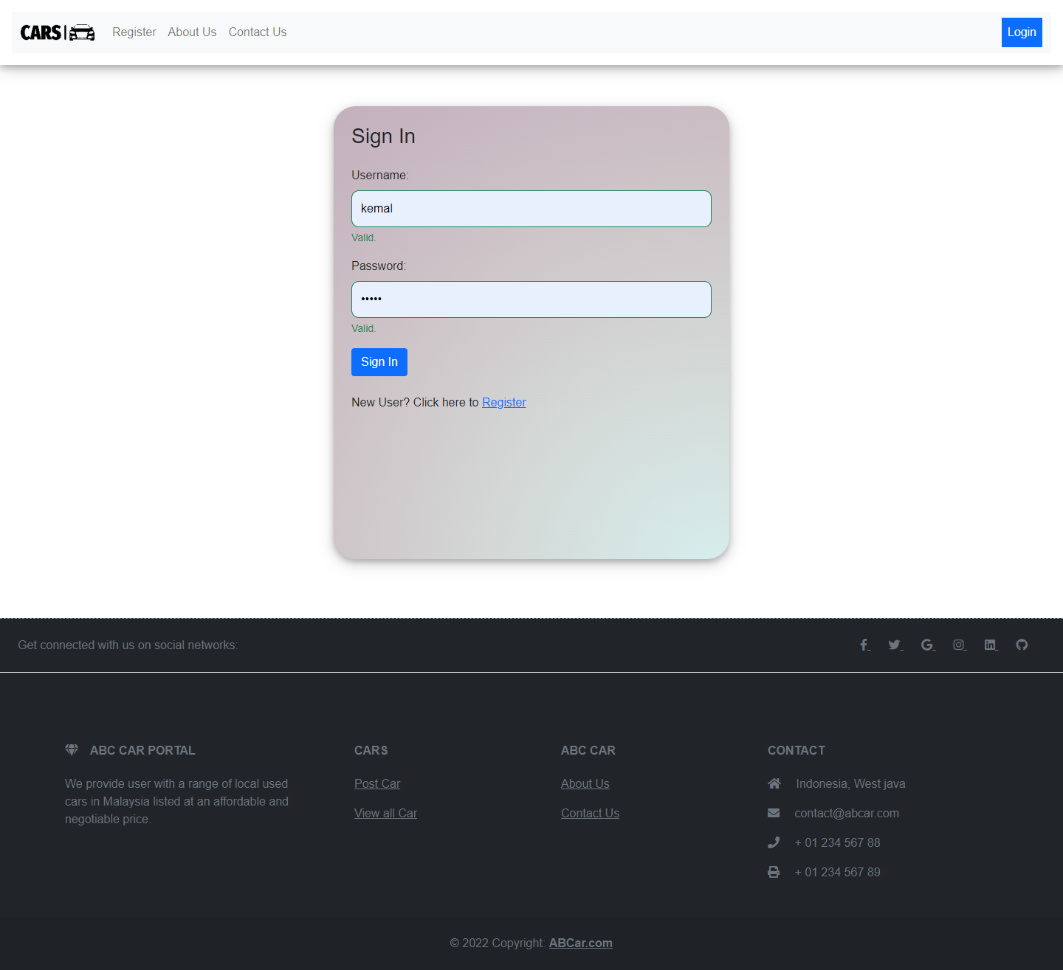

13. Project Results
Provide Screen Capture of Developed Pages

Slide 27
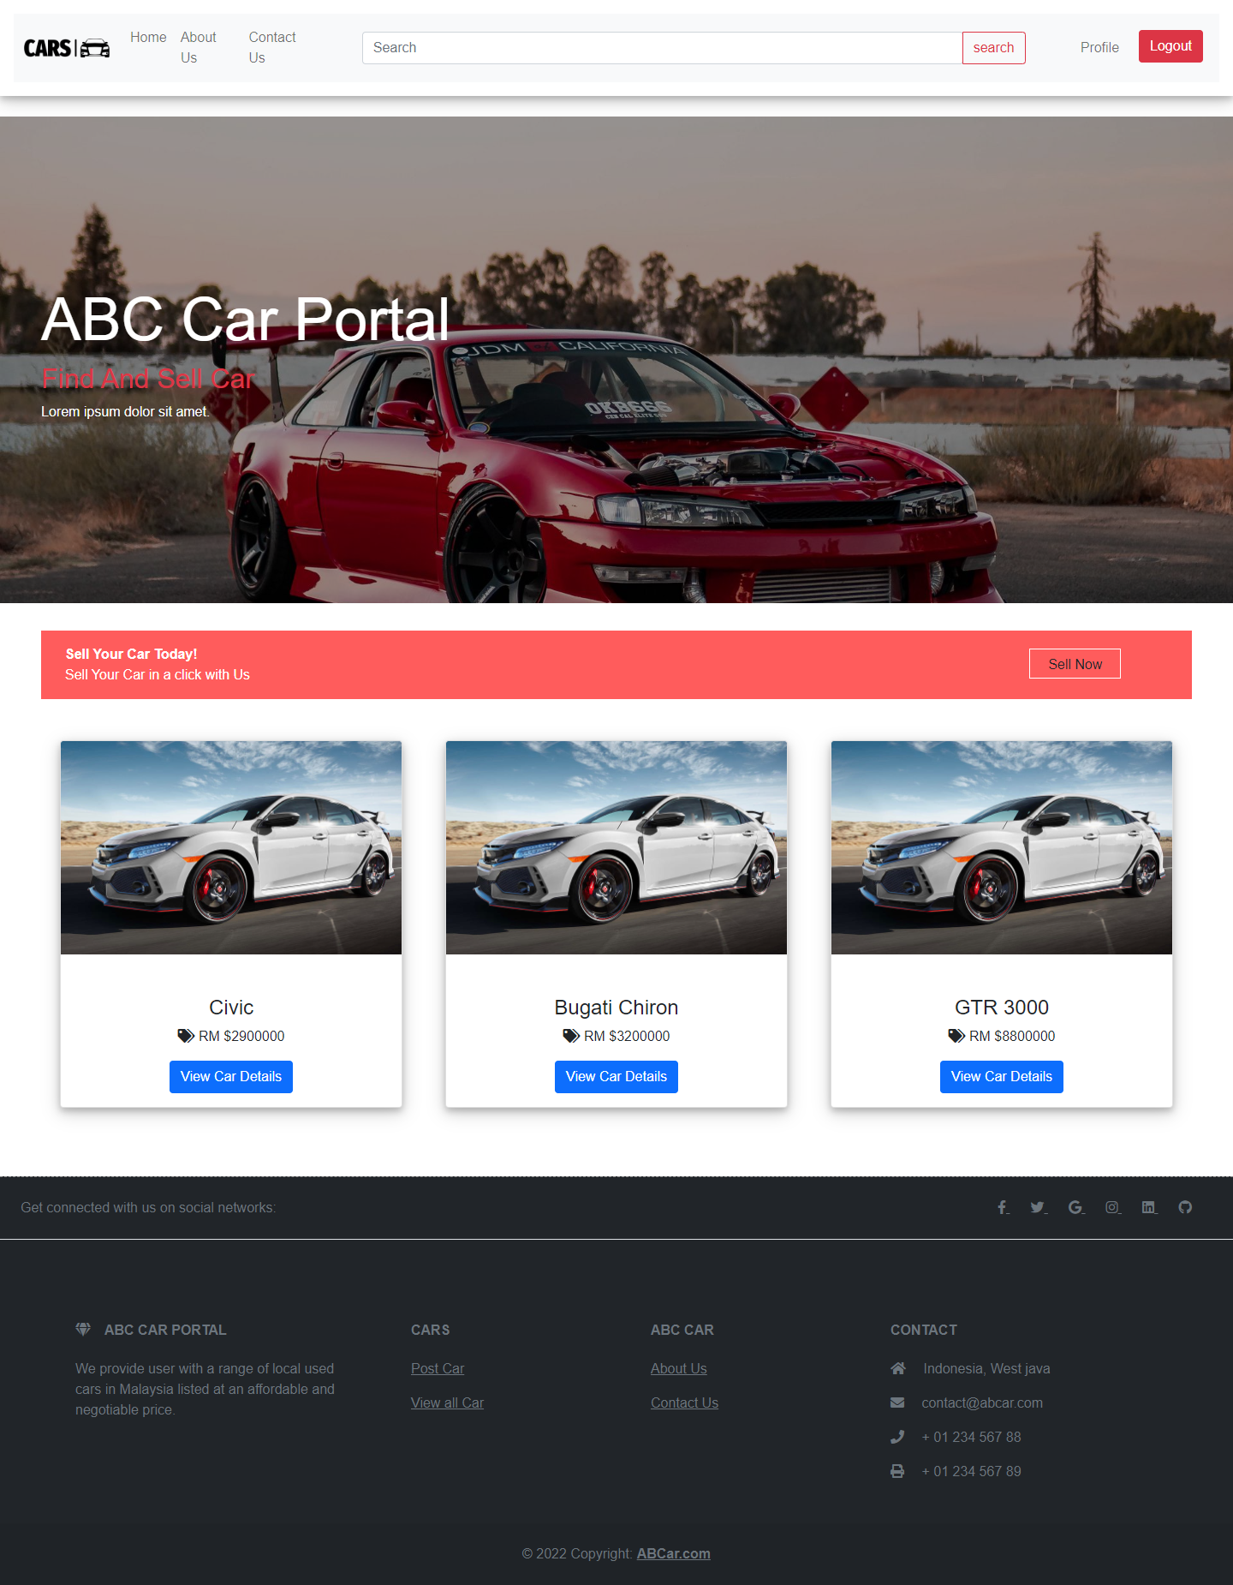
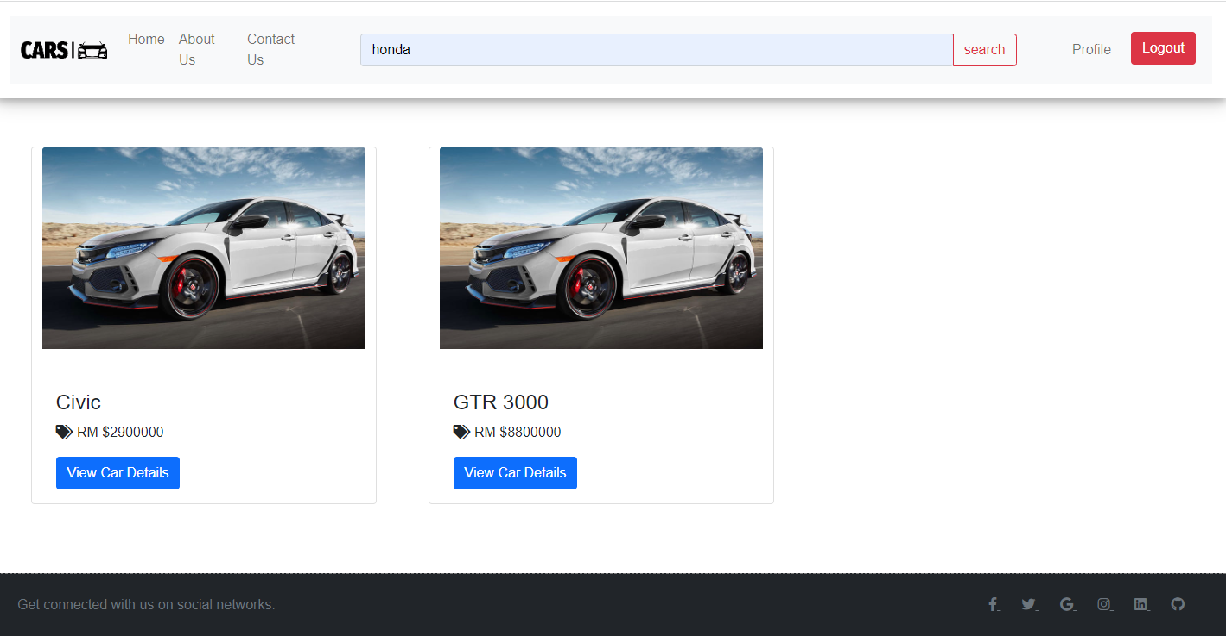

Slide 29
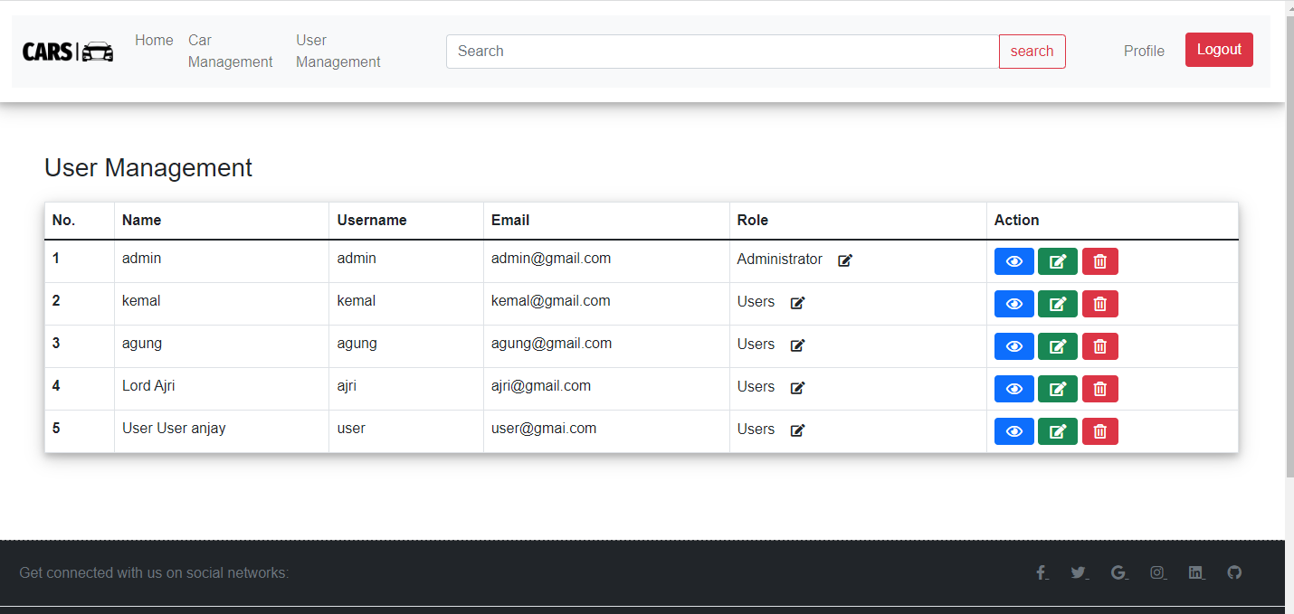
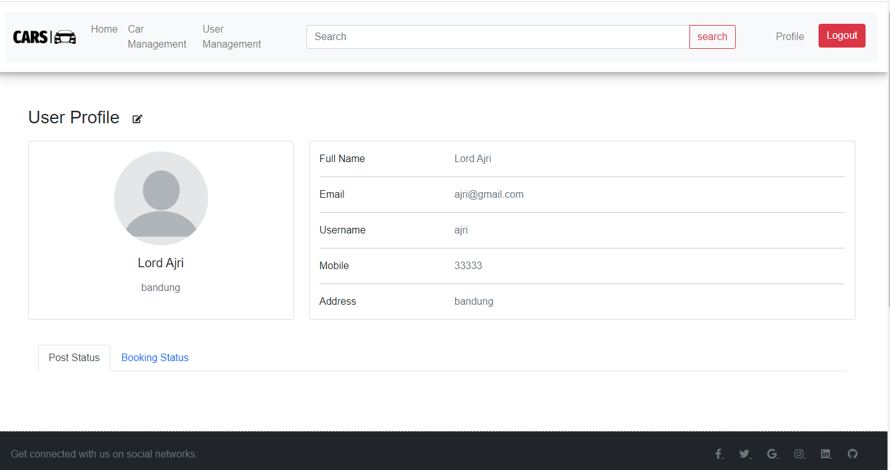

Slide 30
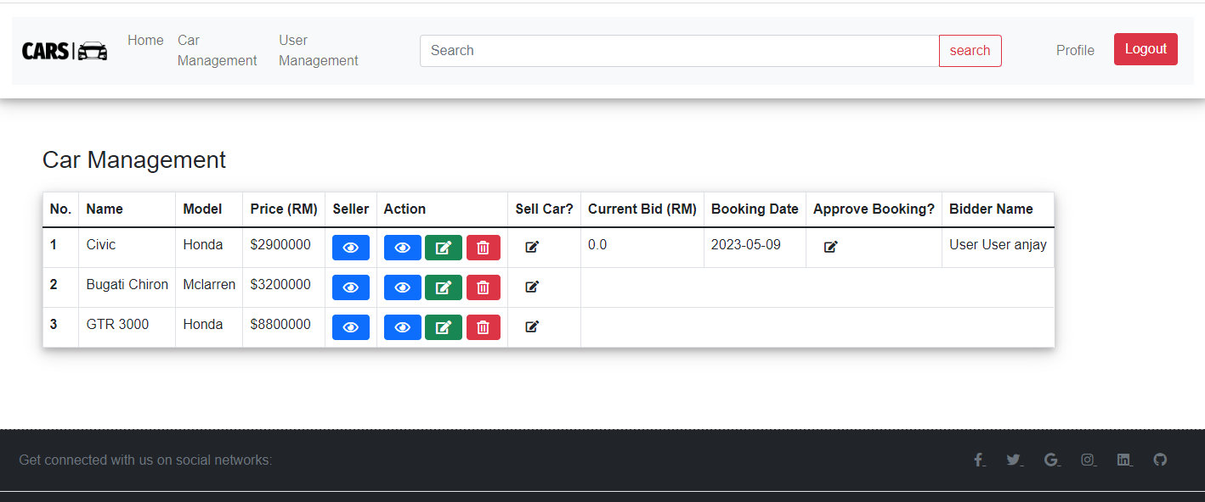
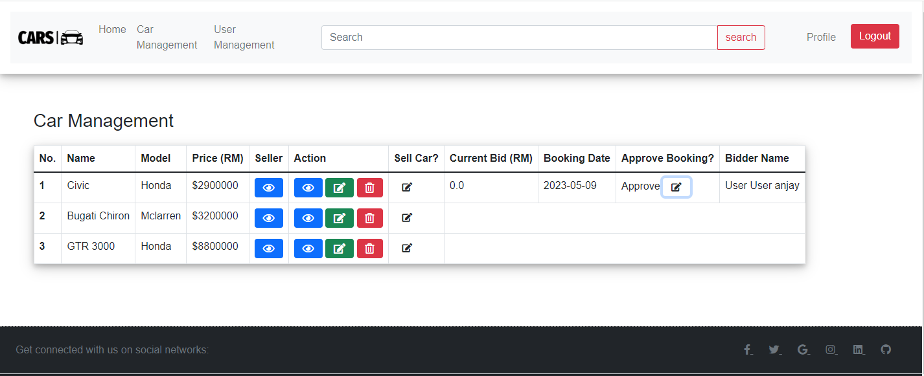

Slide 31
